Slide 1
Neural Network Introduction

Slide 2
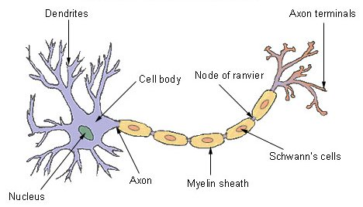
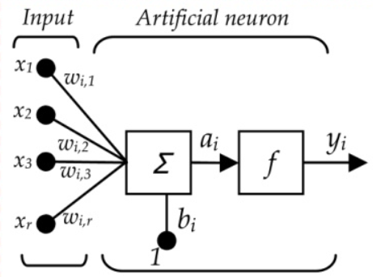
Single Neuron Architecture

Slide 3
Intuition of Multi Layer NN Architecture
Input
Gross Features
Subtle Features
Output Formatting
Output

Slide 4
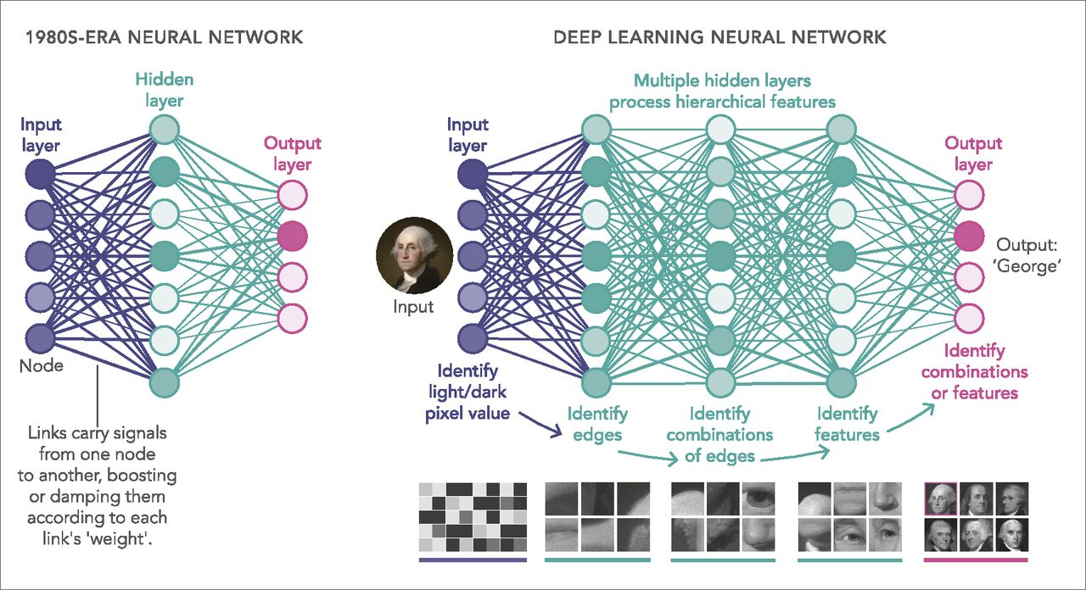
Intuition of Multi Layer NN Architecture

Slide 5
Popular Neural Networks & Tasks
Simple ANN -> Classification/ Regression
Convolutional NN (CNN)-> Image Classification / object detection
Alexnet -> Image classification ( based on CNN)
YOLO (You Only Look Once)-> Object Detection
Recurrent Neural Networks (RNN)-> text processing, time series processing, audio processing
LSTM ( Long Short Term Memory Networks)
Generative Adversarial NN (GAN) → Generate images / Text / Data
Transformers -> Natural Language Processing , Image processing
BERT -> text processing and summarization
Chat GPT (Generative Pre-trained Transformer) -> NLP(Natural Language Processing) and Image
Auto-Encoders -> Compression and De-noising the images / data
Deep-Fake -> generate fake real looking videos

Slide 6
How to Create Your Own NN?
Decisions to be Taken → Fine tune Hyper parameters
Number of Layers
Number of Neurons in Each Layer
Input Layer
Output Layer
Hidden Layer
Activation Function
Learning Rate
Optimization Function

Slide 7
Activation Functions
Linear f(x) = x so y = x
Sigmoid
TanH (Hyperbolic Tangent)
ReLU ( Rectified Linear Unit)

Slide 8
Determining the Right Activation Function
Problem
Linearly separable data
Non-linearly separable
Output
Between 0-1
Having Negative Values
Speed of convergence of Various Activations

Slide 9
Weight Update in Back Propagation
W = W - lr * delta_change
where
delta_change = error_at_layer * slope_of_layer_activation
lr is learning rate

Slide 10
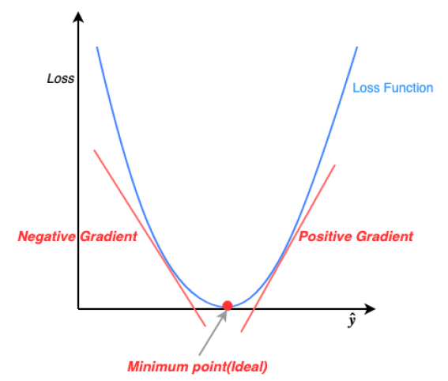
Derivative of Loss / Error in Weight Update
The derivative of the loss function dictates whether to increase or decrease weights.
A positive derivative would mean decrease the weights and negative would mean increase the weights.
The steeper the slope the more incorrect the prediction was.

